Slide 1

Patient Readmission

Slide 2
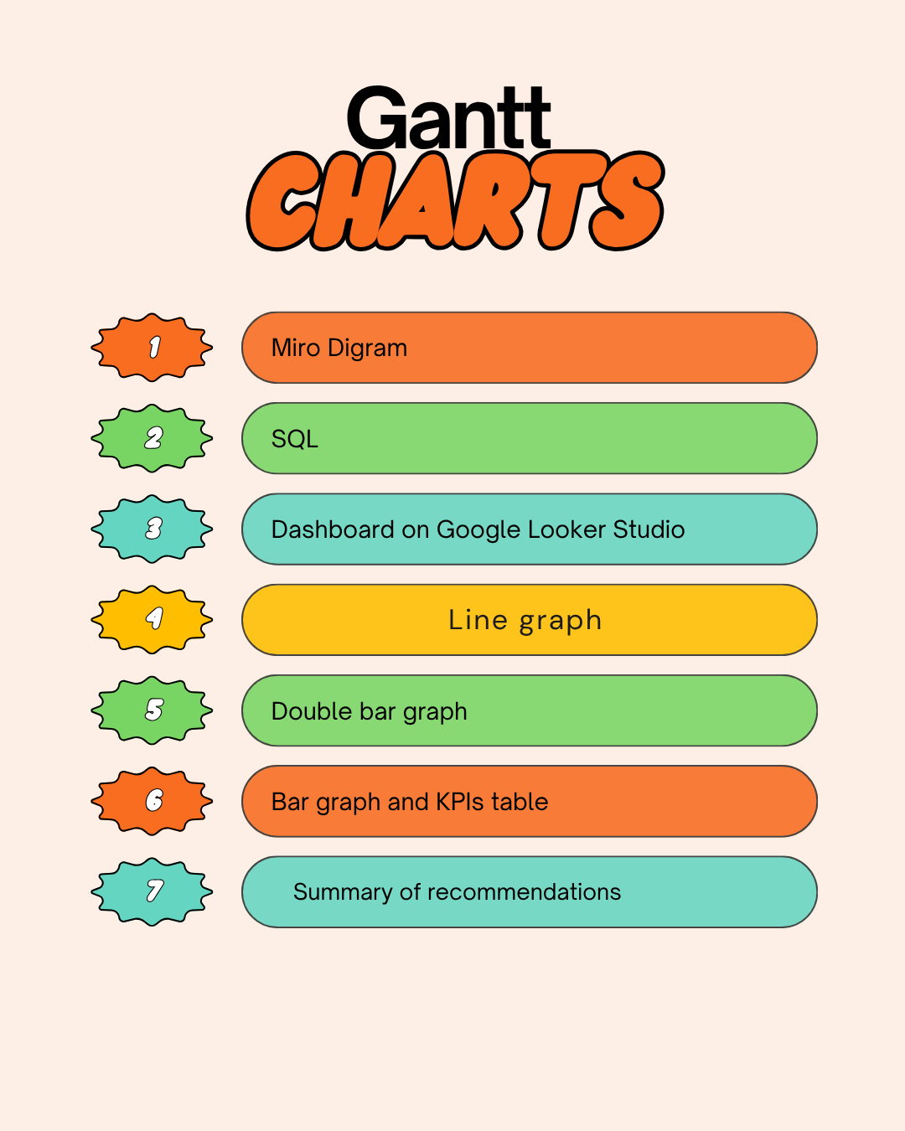

Slide 3
TABLE OF CONTENT
Gantt Charts
Miro Diagram
SQL
Dashboard Looker Studio
Recommendations

Slide 4
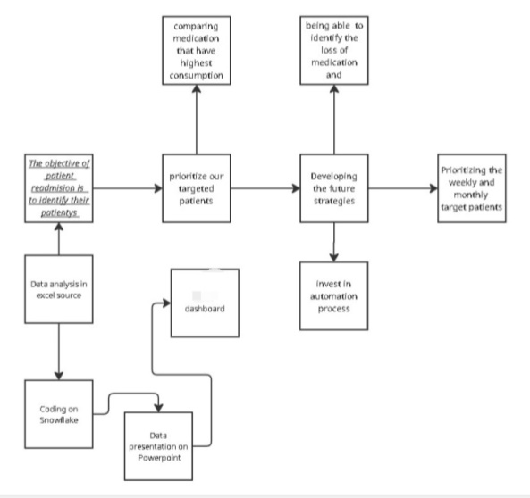
The diagram outline a strategy for managing patient readmissions. It focuses on prioritizing targeted patients, developing future strategies like automation and analyzing data via Excel ,Snowflake and presentation.

Slide 5
SQL
The queries demonstrate the following metric on the Dashboard.
Readmission: % of patients readmitted within certain timeframe.
Average Length of stay: by admission type , age group or diagnosis.
High risk patients: with blood pressure, high blood sugar or admission type.
Top diagnoses: most common diagnoses and their associated readmission rates.

Slide 6
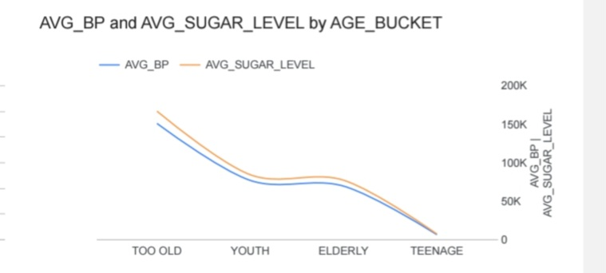
Both BP and Sugar Levels increase with age, peaking in older groups( Too old).
Younger groups (Teenage , Youth) have much lower values – suggesting age has a strong correlation with both metrics.

Slide 7
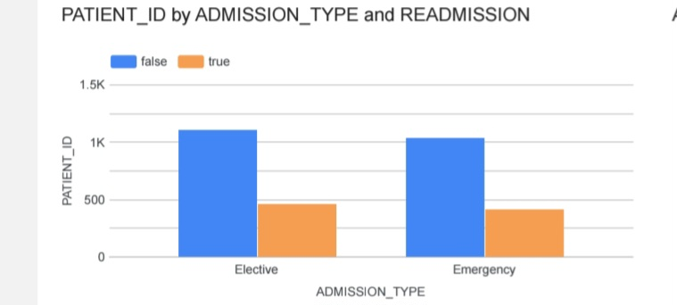
Most patients were not readmitted ( blue bars taller).
Both Elective and Emergency admissions show some readmissions, but emergency patients might have a slightly higher proportion of readmissions – depending on bar height.

Slide 8
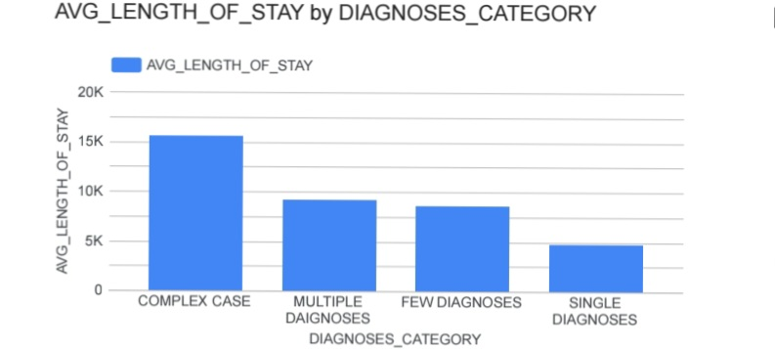
The charts suggests that as the complexity or number of diagnoses increases, the average length of stay also increase.
This indicate that patients with more complicated health conditions require more time for treatment and recovery.

Slide 9
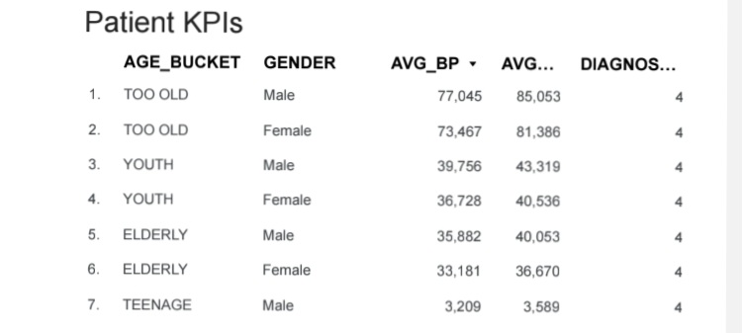
The above table represents older patients (Too old) have high BP and Sugar level, while Teenage patients have the lowest.
This means that blood pressure and Sugar levels increase with age for both genders, with males generally having slightly higher readings than females.

Slide 10
Summary of Recommendations based on all the graphs
The analysis shows that older patients have higher blood pressure and sugar levels, making them more likely to be readmitted.
It is recommended that hospitals strengthen preventive care and regular monitoring for elderly patients. Those with multiple diagnoses tend to stay longer at hospital, highlighting the need for better care coordination and discharge planning.
Follow up care and patient education should be prioritized to help reduce readmission rates for both elective and emergency cases.

Slide 11
THANK YOU
.

Slide 12
.
.

